Slide 1
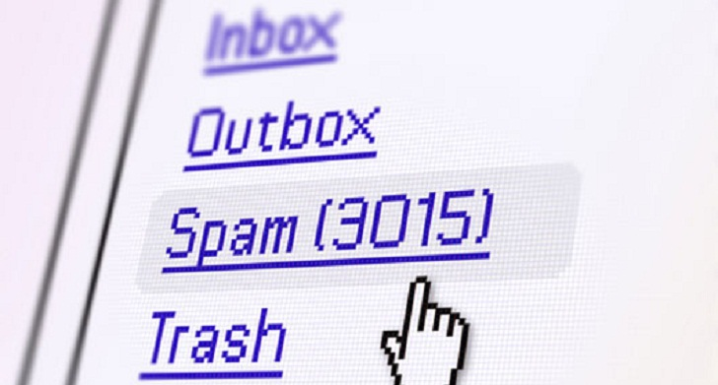
Spam Detection whether a message spam or not ?

Slide 2
Agenda outline
Motivation/Problem Statement
Dataset
Data Cleaning
Shaping the data for ML modelling
Classification models
Comparison & Results

Slide 3
Motivation
Email spam, also known as junk email, is a type of electronic spam where unsolicited messages are sent by email.
The proportion of spam email was around 90% of email messages sent, in the end of 2014.*
It was estimated that in 2009 spam cost businesses around US$130 billion worldwide.#
Many solutions available to tackle this problem, but one of the most efficient is email filtering based on the content of the email.
*Email Metric Report
# Ferris Research : Cost of spam

Slide 4
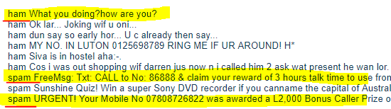
Dataset – SMS Spam Collection
Available at UCI Machine Learning Repository
Number of instances – 5572 ; no missing values
Number of columns – 2 (label & message)
Classification levels – 2 i.e. spam and not spam

Slide 5
High Level NLP flow
Tokenizing
Removing
Stop words
Stemming/
Lemmatizing
Vectorization
ML Modelling

Slide 6
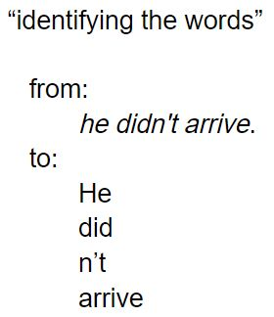
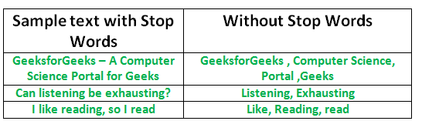
Understanding the NLP steps
Tokenization
Removing stop words

Slide 7
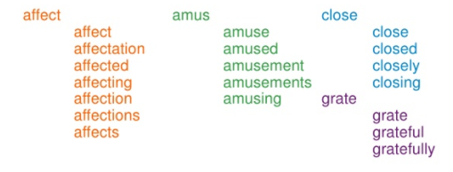
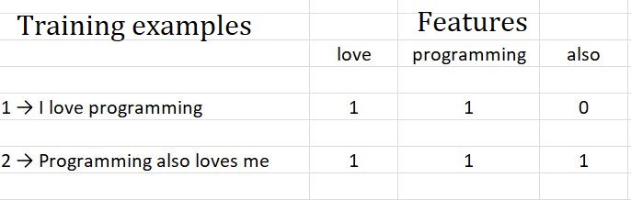
Understanding the NLP steps cont.
Stemming
Vectorization

Slide 8
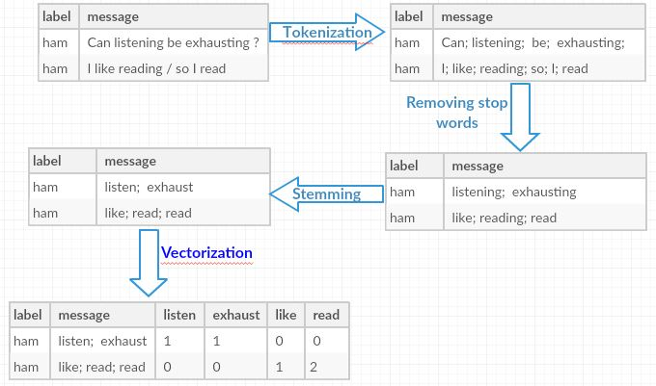
Putting it all together

